Slide 1
CSE-103
Lecture-07: Number Theory
Notes:
‹#›

Slide 2

Integer Arithmetic: The Set of Integers
In integer arithmetic, we use a set and a few operations.
We are already familiar with this set and the corresponding operations, but they are reviewed here to create a background for modular arithmetic.
The set of integers, denoted by Z, contains all integral numbers (with no fraction) from negative infinity to positive infinity.
Figure below shows the set of integers.
Figure: The set of integers
Notes:
‹#›

Slide 3
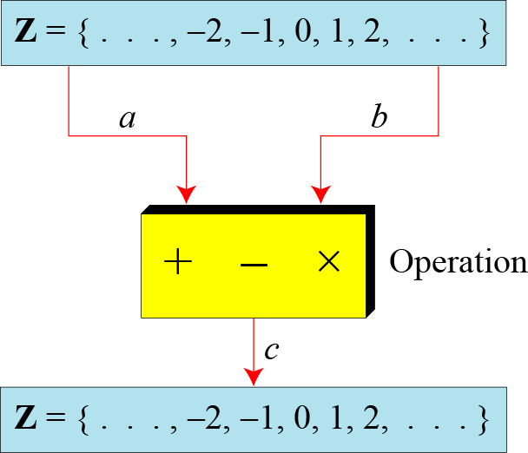
Binary Operations
A binary operation takes two inputs (e.g. a and b) and creates one output (e.g. c).
In cryptography, we are interested in three binary operations applied to the set of integers: addition, subtraction and multiplication.
Figure: Three binary operations for the set of integers
Notes:
‹#›

Slide 4
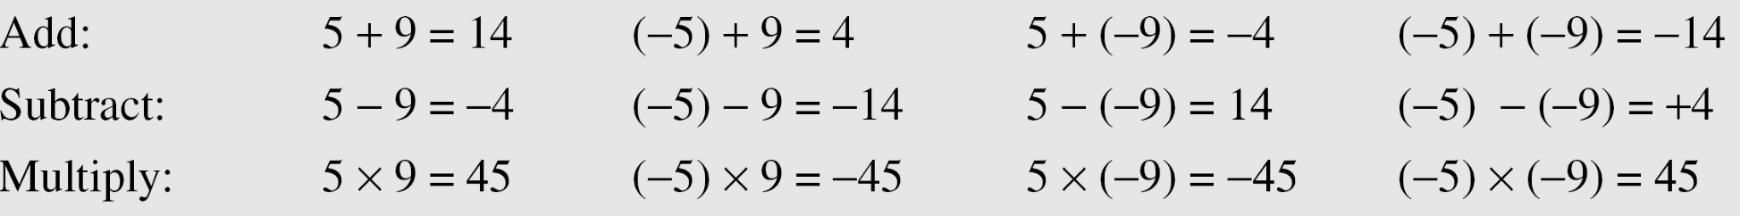
Binary Operations
The following examples shows the results of the three binary operations on two integers.
Because each input can be either positive or negative, we can have four cases for each operation.
Notes:
‹#›

Slide 5
Integer Division
In integer arithmetic, if we divide a by n, we can get q and r. The relationship between these four integers can be shown as
a = q × n + r
Where,
a 🡪 dividend
n 🡪 divisor
q 🡪 quotient
r 🡪 remainder
Note:
Division is not a binary operation, because it produces two output instead of one (q and r). Instead, we can call it division relation.
Notes:
‹#›

Slide 6
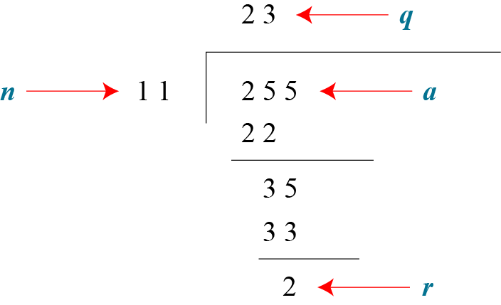
Integer Division
Example:
Assume that a = 255 and n = 11. We can find q = 23 and r = 2 using the division algorithm.
Figure: Finding the quotient and the remainder
Notes:
‹#›

Slide 7
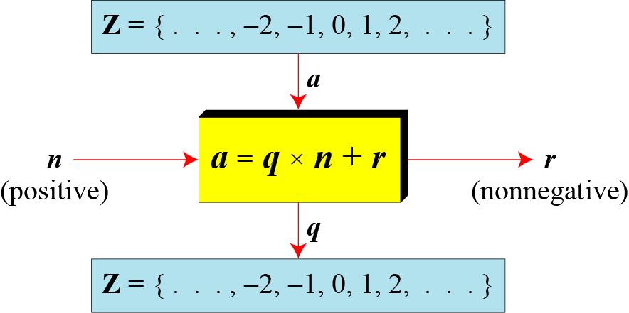
Integer Division
When we use the above division relationship in cryptography, we impose two restrictions:
The divisor be a positive integer (i.e. n>0)
The remainder be a non-negative integer (i.e. r>=0)
Figure: Division algorithm for integers
Notes:
‹#›

Slide 8
Integer Division
Example:
When we use a computer or a calculator, r and q are negative when a is negative.
How can we apply the restriction that r needs to be positive?
The solution is simple, we decrement the value of q by 1 and we add the value of n to r to make it positive.
n
r
r = n + r
q
q = q-1
Notes:
‹#›

Slide 9
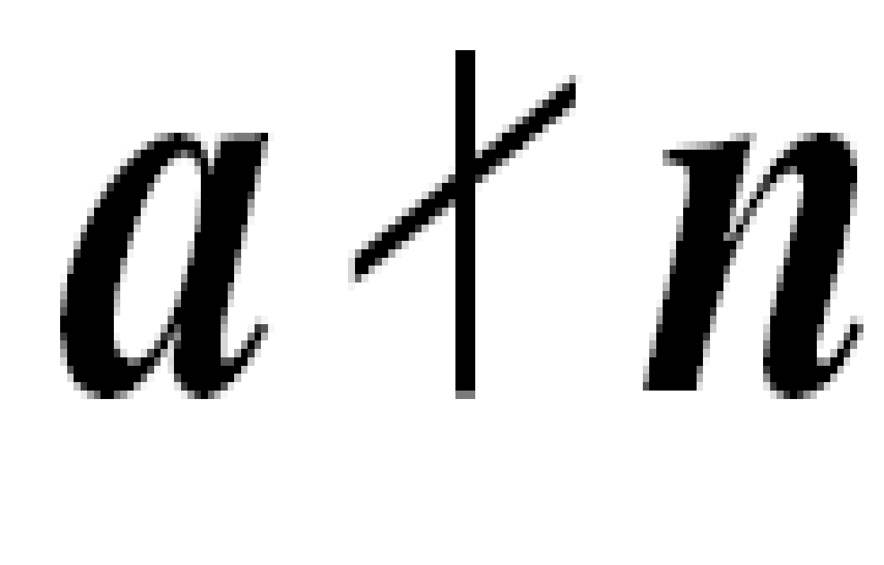
Divisibility
Division relation is:
a = q × n + r
Where
a 🡪 dividend
n 🡪 divisor
q 🡪 quotient
r 🡪 remainder
If a is not zero and we let r = 0 in the division relation, we get:
a = q × n
We then say that
n divides a
or, n is a divisor of a
or, a is divisible by n
Therefore, when a is divisible by n and we are not interested in the value of q, we can write the above relation as a|n
If a is not divisible by n (i.e. if r is not zero), then we can write the above relation as
Notes:
‹#›

Slide 10
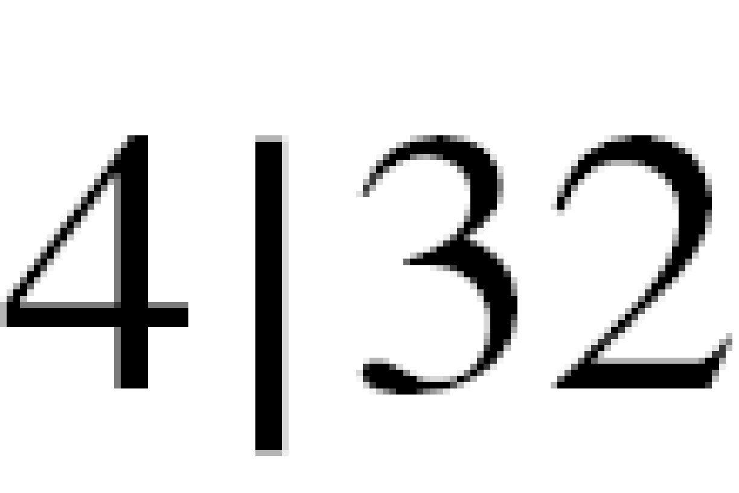
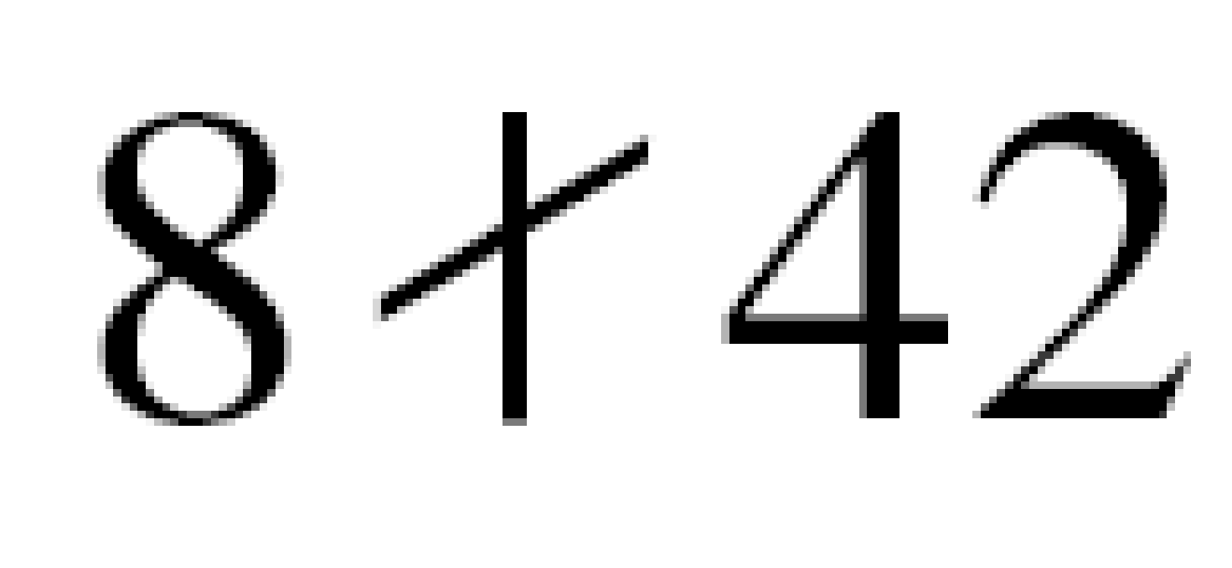
Divisibility
Example :
The integer 4 divides the integer 32 because 32 = 8 × 4. We show this as
b. The number 8 does not divide the number 42 because
42 = 5 × 8 + 2. There is a remainder, the number 2, in the equation. We show this as
Example:
Notes:
‹#›

Slide 11
GCD: Greatest Common Divisor
A positive integer can have more than one divisor. For example, the integer 32 has six divisors: 1, 2, 4, 8, 16, 32.
We can mention two interesting facts about divisors of positive integers:
Fact 1:
The integer 1 has only one divisor, itself.
Fact 2:
Any positive integer has at least two divisors, 1 and itself (but it can have more).
The greatest common divisor (GCD) of two positive integers is the largest integer that can divide both integers.
GCD is often needed in cryptography.
Two positive integers may have many common divisors, but only one is the greatest of them.
For example, the common divisors of 12 and 140 are: 1, 2, and 4. However, the greatest common divisor is 4.
Notes:
‹#›

Slide 12
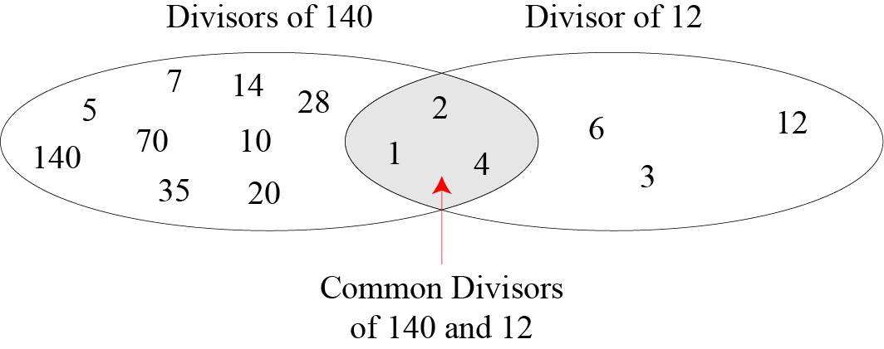
GCD: Greatest Common Divisor
Figure: Common divisors of two integers
Notes:
‹#›

Slide 13
GCD Using Euclidean Algorithm
Finding the GCD of two positive integers by listing all common divisors is not practical when the two integers are large.
More than 2000 years ago, a mathematician named Euclid developed an algorithm that can find the GCD of two large positive integers.
The Euclidian algorithm is based on the two facts:
Fact 1: When 2nd integer is zero, then gcd (a, 0) = a
Example: gcd(5, 0) = 5
Fact 2: When both integer is positive, then gcd (a, b) = gcd (b, r), where r is the remainder of dividing a by b (here the value of first and second integer is changed until the second integer becomes zero.
Example:
Gcd(36, 10) = gcd(10, 6) = gcd(6, 4) = gcd(4,2) = gcd(2, 0) = 2
Notes:
‹#›

Slide 14
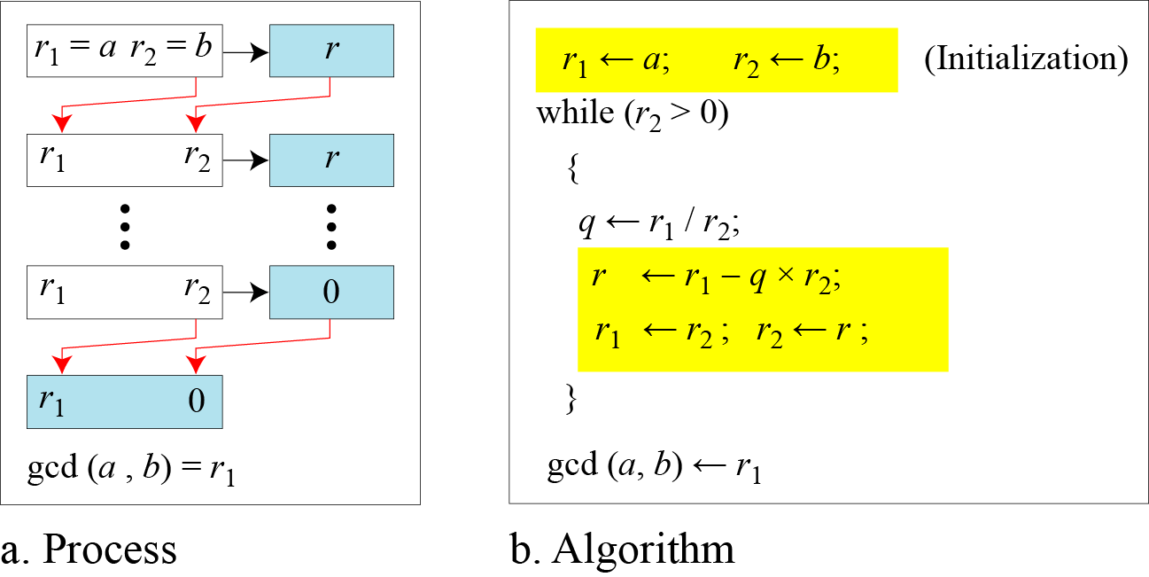
GCD Using Euclidean Algorithm
Figure below shows how we use Fact 1 and Fact 2 to calculate gcd (a, b)
Figure: Euclidean Algorithm
Note:
When gcd (a, b) = 1, we say that a and b are relatively prime or they are coprime.
Notes:
‹#›

Slide 15
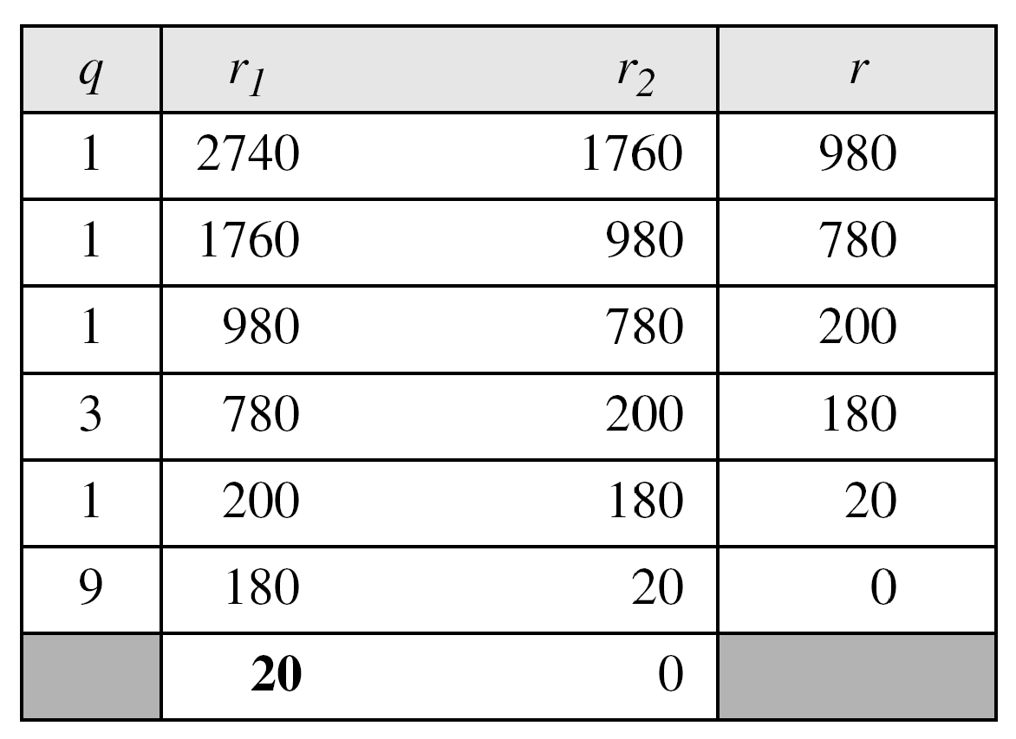
GCD Using Euclidean Algorithm
Example:
Find the greatest common divisor of 2740 and 1760.
Solution:
We have gcd (2740, 1760) = 20.
Notes:
‹#›

Slide 16
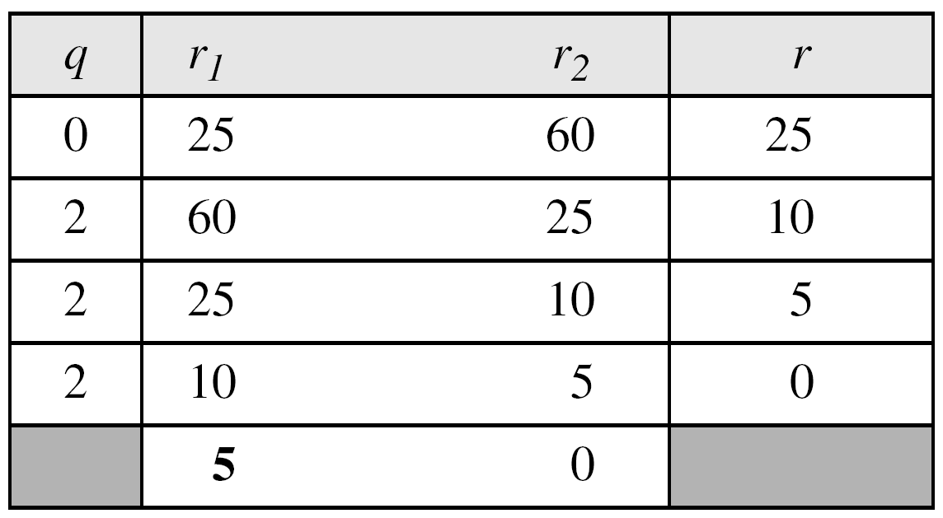
GCD Using Euclidean Algorithm
Example:
Find the greatest common divisor of 25 and 60.
Solution:
We have gcd (25, 60) = 5.
Note:
The above example shows that it does not matter if the first number is smaller than the second number. We immediately get our correct ordering gcd(60, 25).
Notes:
‹#›

Slide 17
Modular Arithmetic
Given any positive integer n and any nonnegative integer a, if we divide a by n, we get an integer quotient q and an integer remainder r such that a = q × n + r.
This division relation has two inputs (a and n) and two outputs (q and r).
In modular arithmetic, we are interested in only one of the outputs, the remainder r. In other words, we want to know what is the value of r when we divide a by n. This implies that, using modular arithmetic, we can change the division relation into a binary operator (called modulo operator) with two inputs a and n and one output r.
Several important cryptosystems make use of modular arithmetic.
Notes:
‹#›

Slide 18
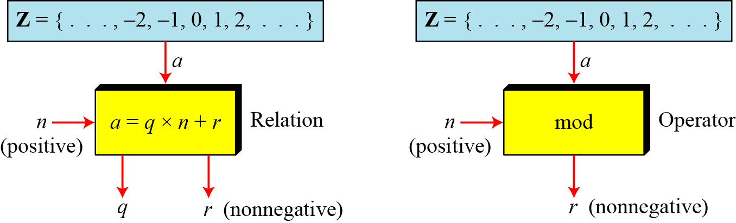
Modular Arithmetic
The modulo operator is shown as mod. The second input (n) is called the modulus. The output r is called the residue.
Figure below shows the division relation compared with the modulo operator.
Figure: Division relation Vs. modulo operator
In the figure we see that the modulo operator (mod) takes an integer (a) from the set of integers (Z) and a positive modulus (n). The operator creates a non-negative residue (r) where 0 <= r <= n-1. We can say that:
a mod n = r
Notes:
‹#›

Slide 19
Modular Arithmetic
Calculation of a mod n:
There are three cases:
Case-1: When both of a and n is positive integer where a<n:
In this case, we add as many multiples of n with a as necessary to get a greater than n. Then divide a by n to get the remainder r. The result will be in the range 0 to n-1.
For example, 2 mod 7 = 9 mod 7 = 2.
Case-2: When both of a and n is positive integer where a>=n:
In this case, just divide a by n to get the remainder r. The result will be in the range 0 to n-1.
For example, 9 mod 7 = 2.
Case-3: When a is negative and n is positive integer:
In this case, we add as many multiples of n with a as necessary to get a positive and greater than n. Then divide a by n to get the remainder r. The result will be in the range 0 to n-1. The process is known as modulo reduction.
For example, -12 mod 7 = -5 mod 7 = 2 mod 7 = 9 mod 7
Notes:
‹#›

Slide 20
Modular Arithmetic
Example:
Find the result of the following operations:
a. 27 mod 5 b. 36 mod 12
c. −18 mod 14 d. −7 mod 10
Solution:
Dividing 27 by 5 results in r = 2. Therefore 27 mod 5 = 2
Dividing 36 by 12 results in r = 0. Therefore 36 mod 12 = 0
c. Dividing −18 by 14 results in r = −4. After adding the modulus (14) with the result to make it non-negative, we have r = -4 + 14 = 10. Therefore -18 mod 14 = 10
d. Dividing −7 by 10 results in r = −7. After adding the modulus (10) with the result to make it non-negative, we have r = -7 + 10 = 3. Therefore –7 mod 10 = 3
Notes:
‹#›

Slide 21
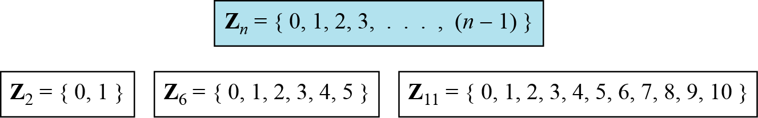
Z_{n}: Set of Residues
The result of a mod n is always an integer between 0 and n-1.
Therefore, the modulo operation creates a set, which in modular arithmetic is referred to as the set of least residues modulo n, or Z_{n}.
Figure below shows the set of residues Z_{n} and three instances of the set of residues Z₂, Z₆, Z₁₁.
Figure: Some Z_{n} sets
Notes:
‹#›

Slide 22
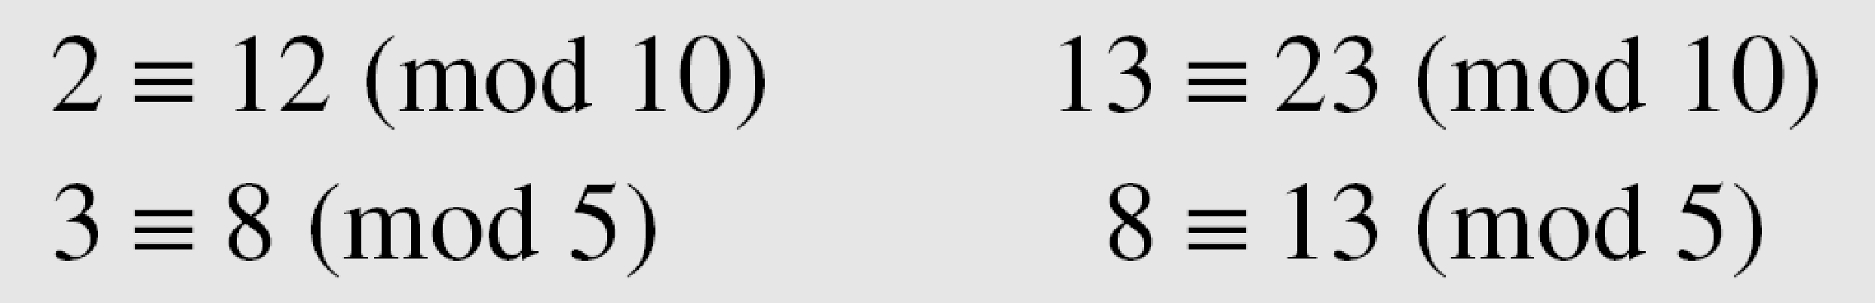
Congruence
The result of 2 mod 10 = 2, 12 mod 10 = 2, 22 mod 10 = 2, 32 mod 10 = 2 and so on.
In modular arithmetic, integers like 2, 12, 22 and 32 are called congruent mod 10.
To show that two integers are congruent, we use the congruence operator ( ≡ ). For example, we write:
Notes:
‹#›

Slide 23
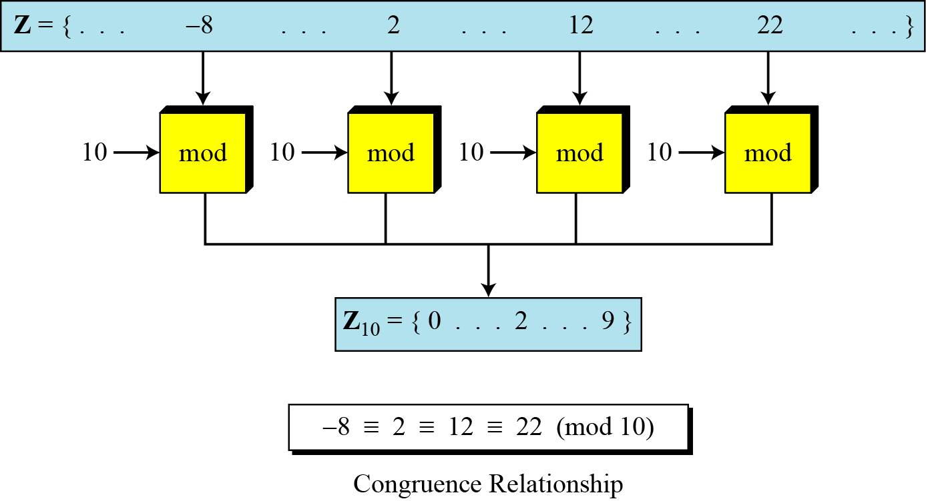
Congruence
Figure below shows the idea of congruence.
Figure 2.11 Concept of congruence
Notes:
‹#›

